Slide 1
Web Grade and LDA Entry Use this link to log directly into Faculty Application https://eservices.minnstate.edu/faculty/public/secure/home/index?campusid=076

Slide 2
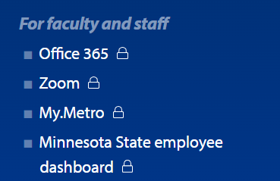
From Home Page(NEW)Scroll to Bottom of Page Select MN State Emp Dashboard or click on this link to go directly to faculty application log in https://eservices.minnstate.edu/faculty/public/secure/home/index?campusid=076
Click on MN state emp dashboard
Notes:
Click on Portal or (go directly to eServices and enter your STAR id and password

Slide 3
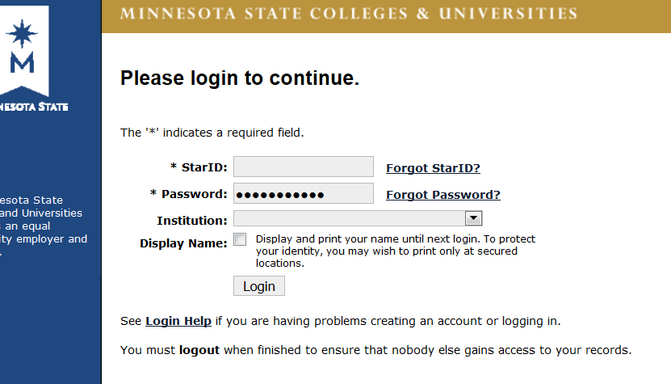
Log in with star id and password
Notes:
Log in with your Username and Password

Slide 4
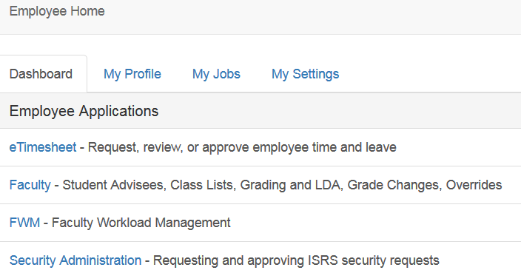
Employee Home
Under Employee Applications Select Faculty
Notes:
Under Collaboration Sites: Select sServices

Slide 5
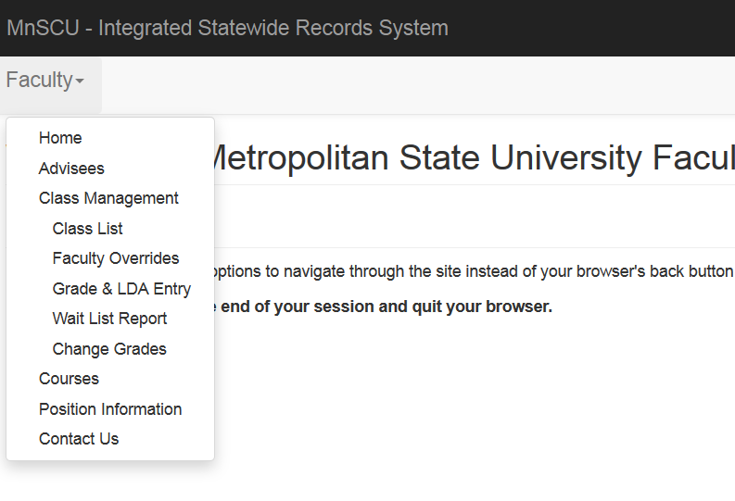
Pictures
Select Grade and LDA Entry
Notes:
Select Grade and LDA Entry

Slide 6
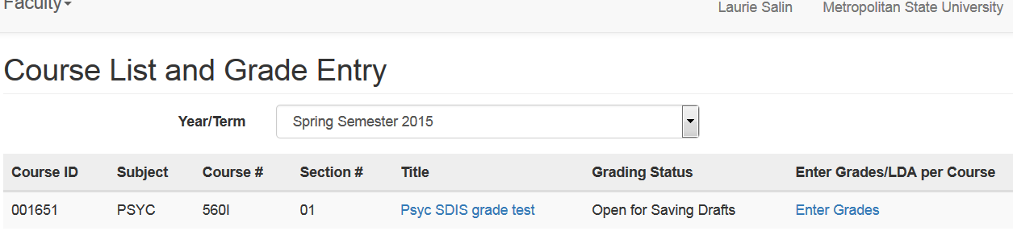
Select YearTerm / Click on Enter Grades
Notes:
Grading Status will say Open for Posting(5 days prior to end of semester) or Open for Saving Draft

Slide 7
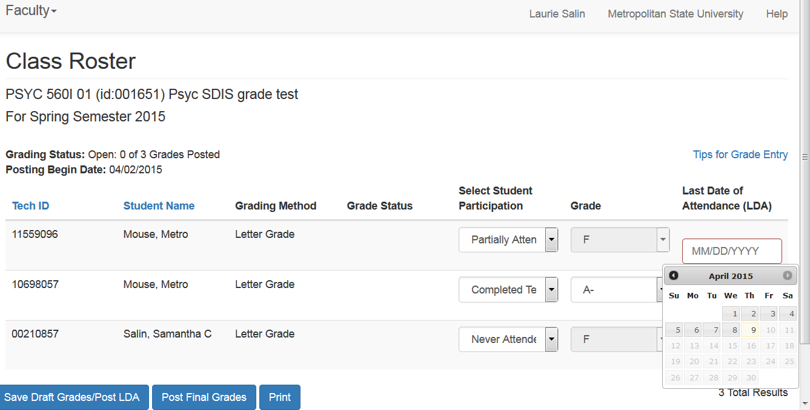
There will be a select all box that you need to select in order to submit grades or you may use check mark next to each students name Select Student Participation :Select Grade(do not use A+)
No LDA is needed for passing grades If you Choose Partial Attend you Must Enter LDA.
If you select Never Attended the LDA will auto load
Notes:
Click on Post Final Grades

Slide 8
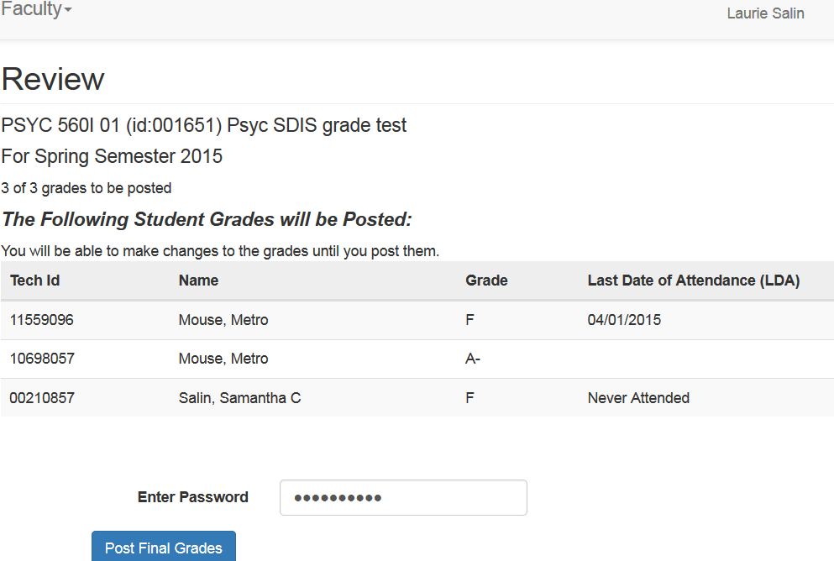
Review Grades: Enter Password select Post Final Grades

Slide 9
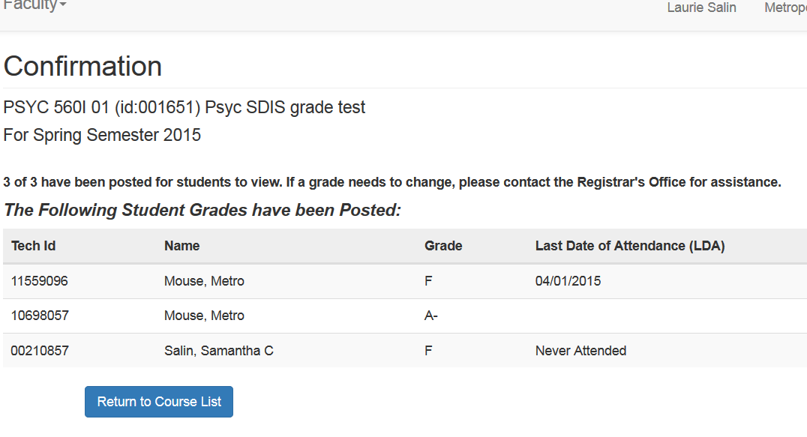
Confirmation : How Many Grades have Posted- Grade Given and LDA- Click on Return to Course List

Slide 10
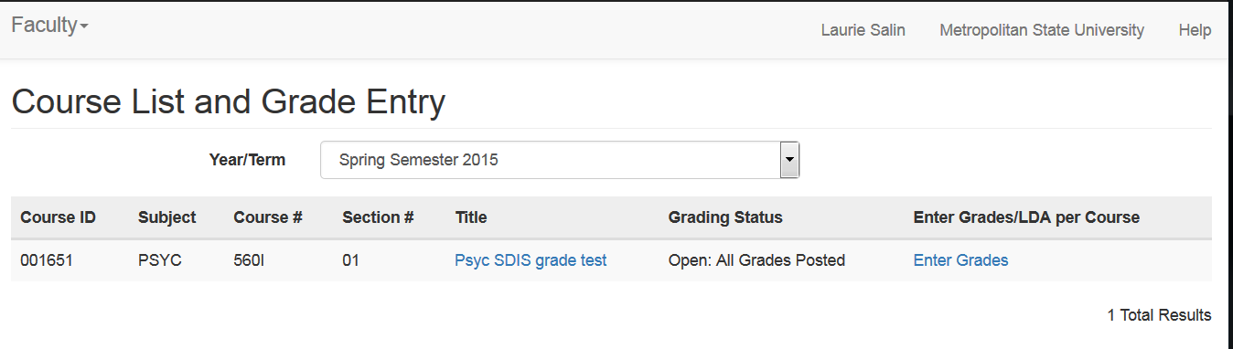
Grading Status will now say: All Grades Posted-If You Click on Enter Grades you can View Posted Grades

Slide 11
https://starid.minnstate.edu/
If you need assistance with StarID/or password, or need technical assistance, the quickest and easiest way to get information is via the StarID Self Service portal.

